Slide 1
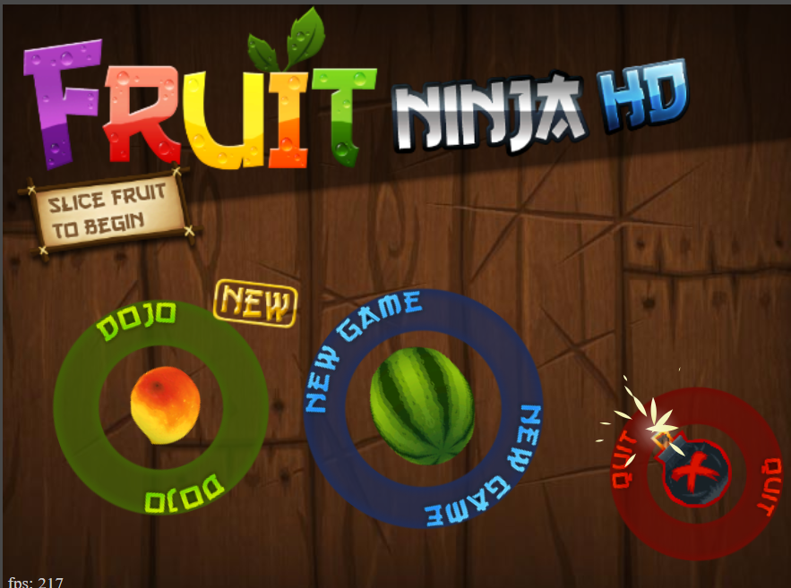
FRUIT NINJA USING JAVASCRIPT Team ID: Y20-CSE-06
Done by
2010030168- TAHSEEN BEGUM
2010030165- SYED RESHMA BANU
2010030129 – SAI GEETHIKA
2010030046 – E. PRAVALLIKA

Slide 2
Problem Statement
Fruit ninja game is a game in which as the fruit is thrown onto the screen, the player swipes their finger/cursor across the screen to create a slicing motion, attempting to slice the fruit in half.

Slide 3
Abstract:
The fruit ninja game, also known as a fruit-slicing game, is easy to play. Fruit ninja game is popular among children.
This project aims to build a fruit ninja game with JavaScript and HTML5. This game is built with the help of the visual studio using the concepts of basic Java Script.
The user has to cut the fruits in this game by touching the mouse on fruits. There are also bombs with fruits. If the mouse touches one bomb then the game will be over or else if the user didn’t Cut the fruit three times then the game will be over.

Slide 4
THANK YOU

